Slide 1


PARTNERSHIP PLAYBOOK
Brand Guidelines

Slide 2
WELCOME
Here in this presentation, you’ll find inspiration and guidance on how you can incorporate TABASCO® Brand in your marketing materials:
TABASCO® Brand Identity
Logos, wordmark and creative
Trademark/legal guidelines
*All creative with any TABASCO® Brand trademarks must be approved by a McIlhenny Company Team Member

Slide 3
TABASCO® BRAND IDENTITY

Slide 4
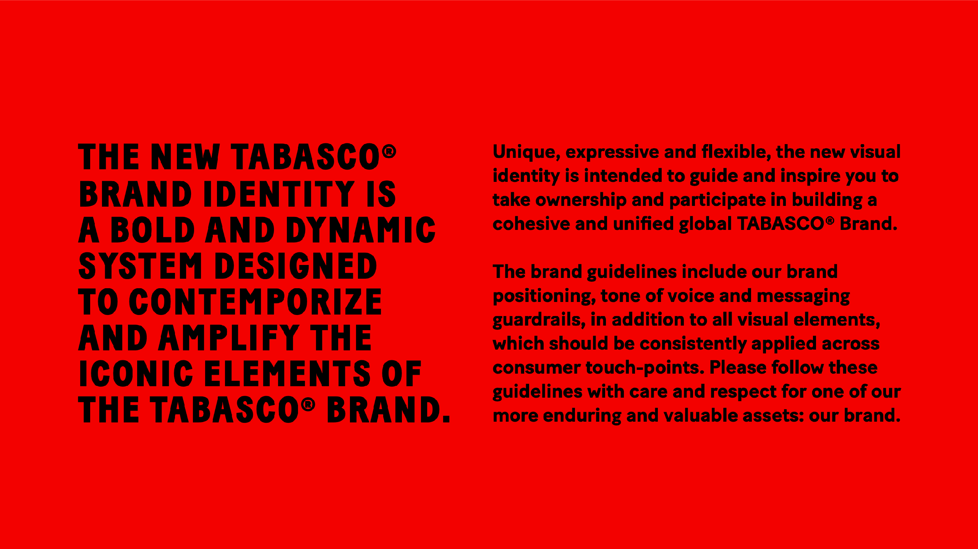

Slide 5
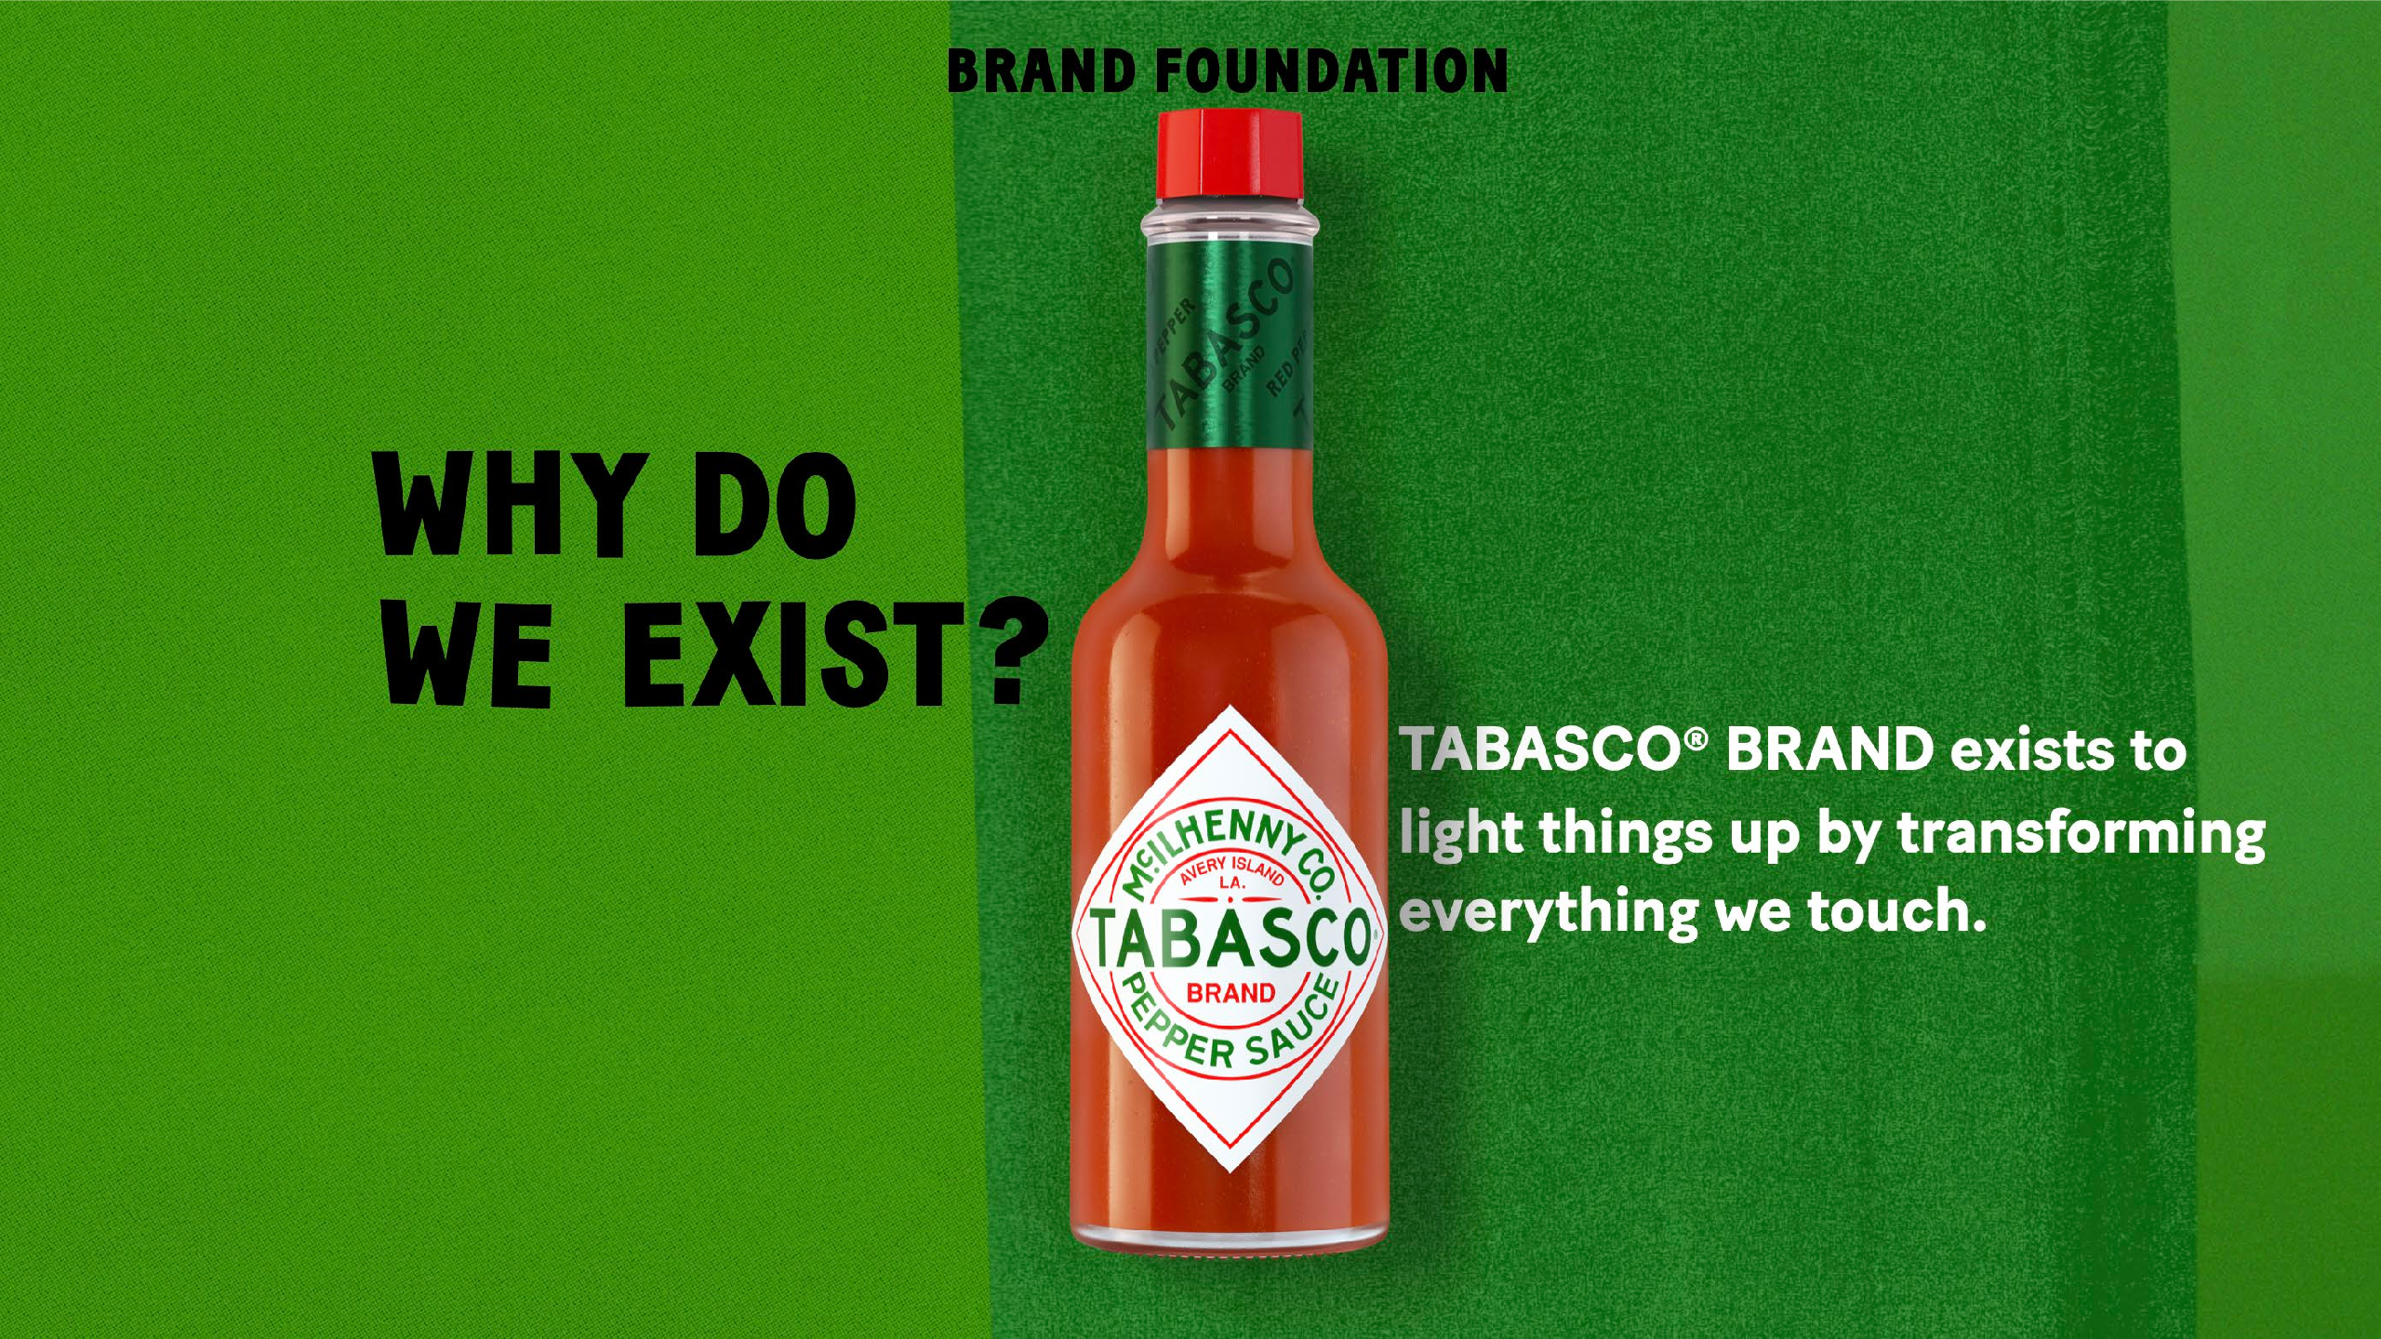

Slide 6
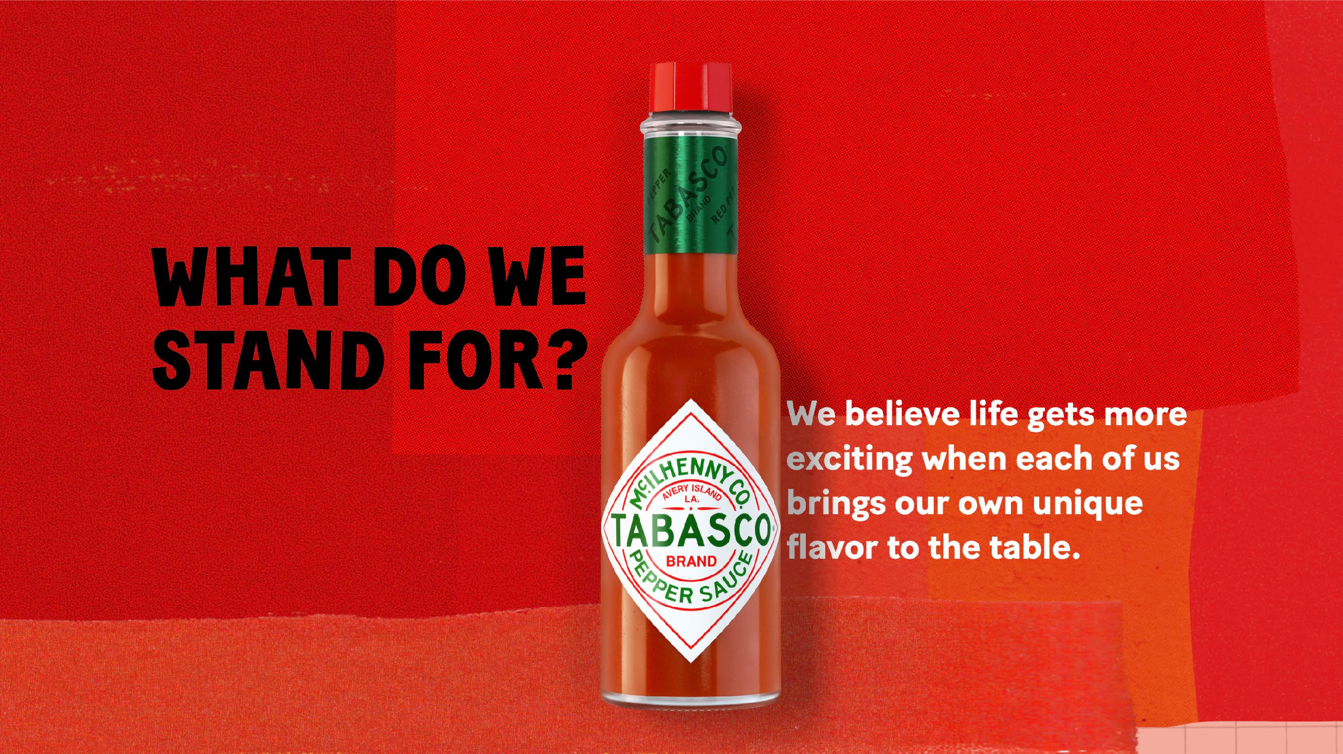

Slide 7
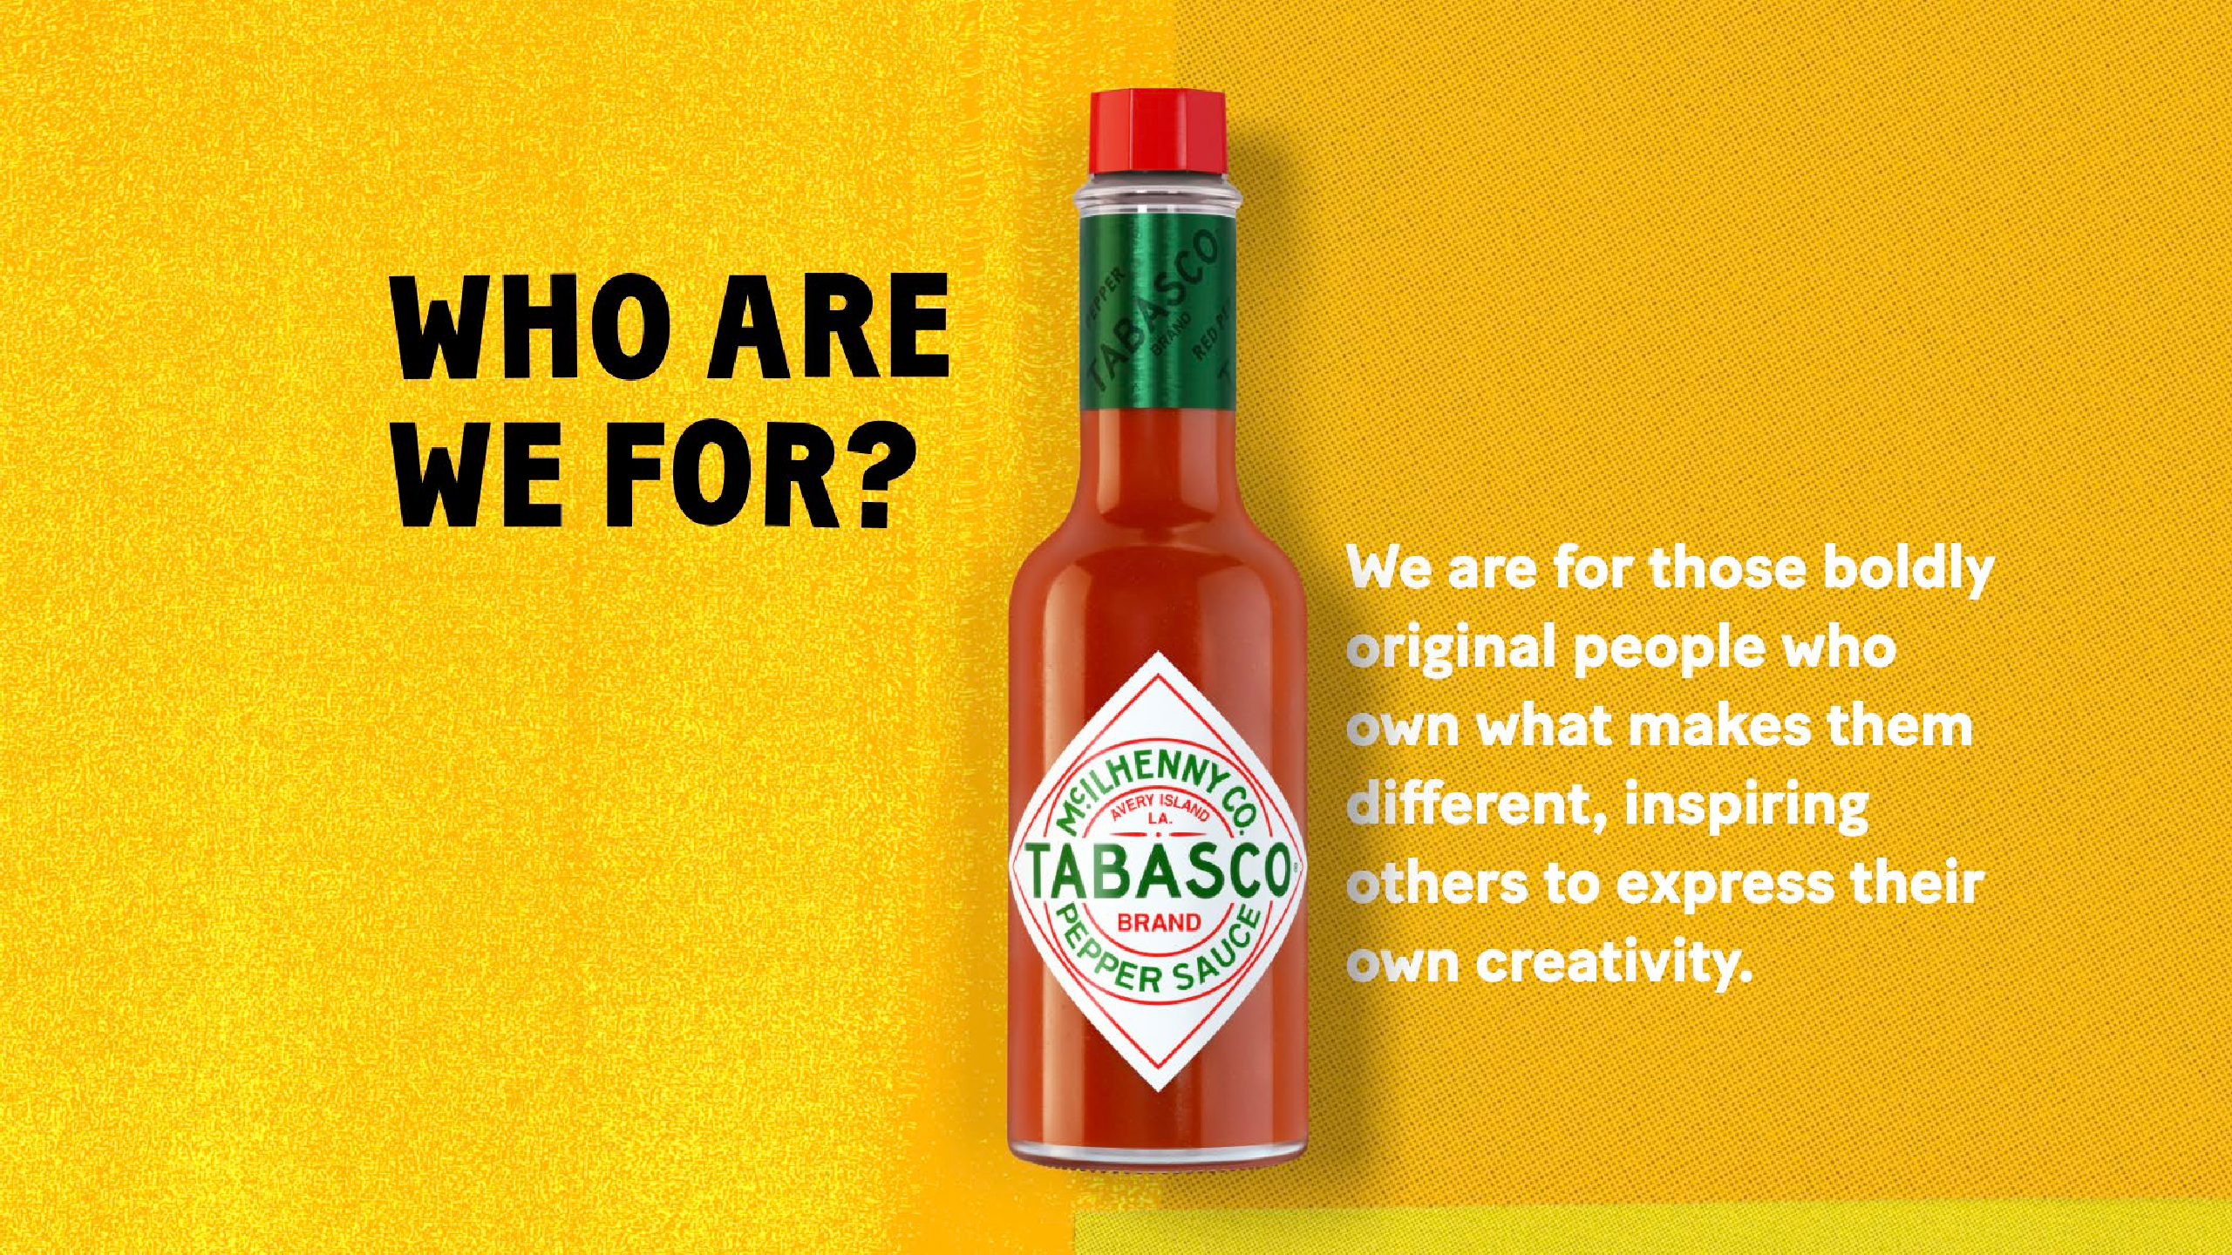

Slide 8
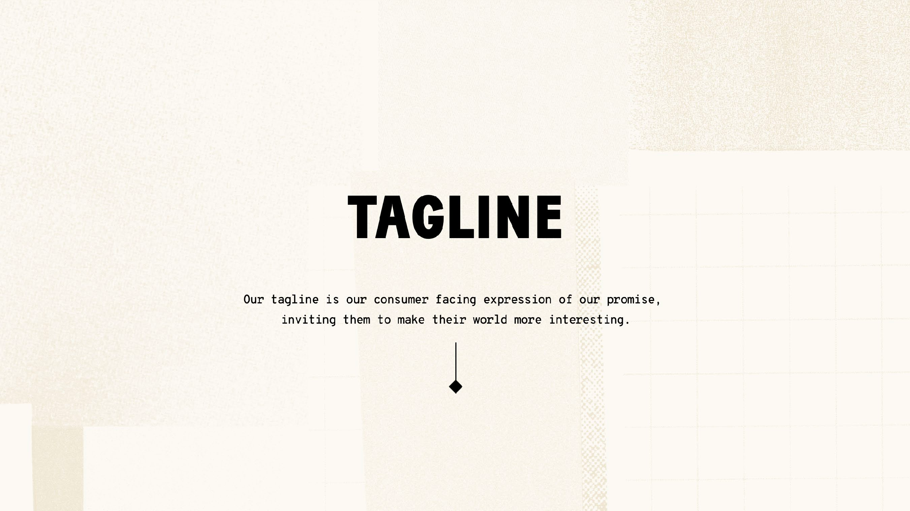

Slide 9

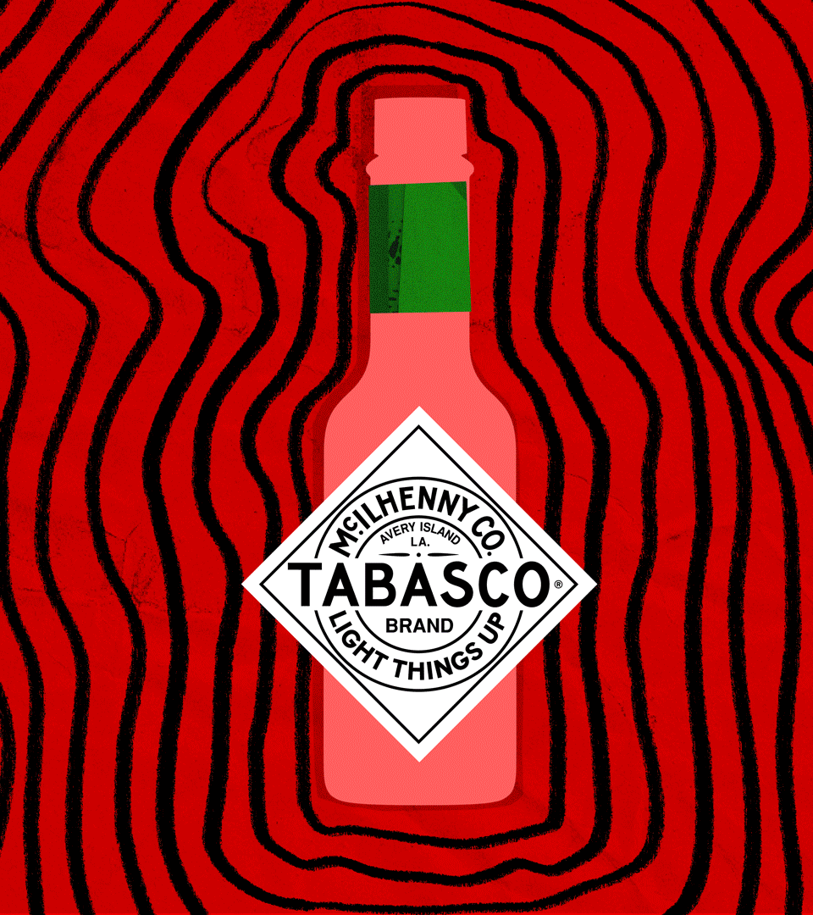

Slide 10
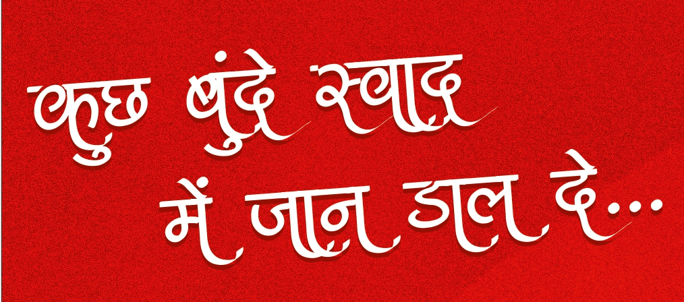
REGIONAL LANGUAGE TRANSLATION

Slide 11
LOGOS, WORDMARK AND CREATIVE

Slide 12









WORDMARKS
FILES FOR THE SAME ARE ATTACGHED.
BRAND WORDMARK
VERTICAL WORDMARK

Slide 13
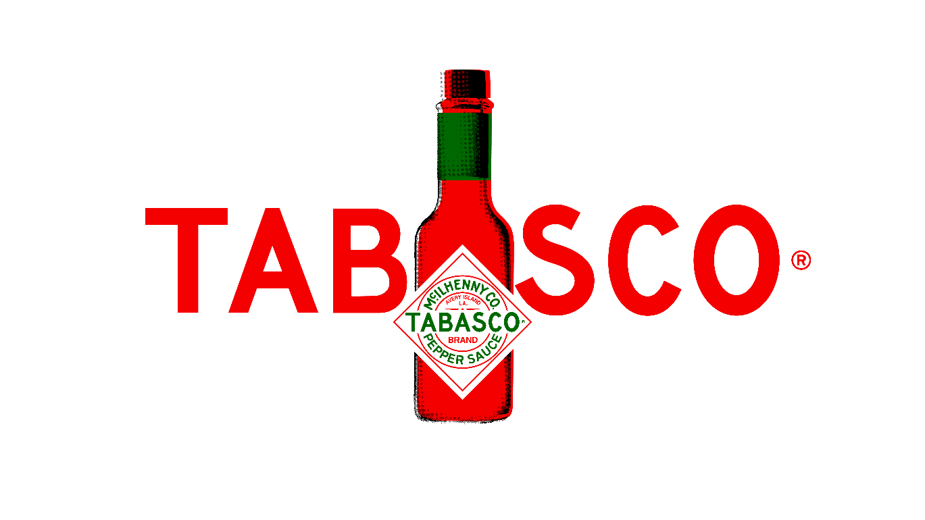
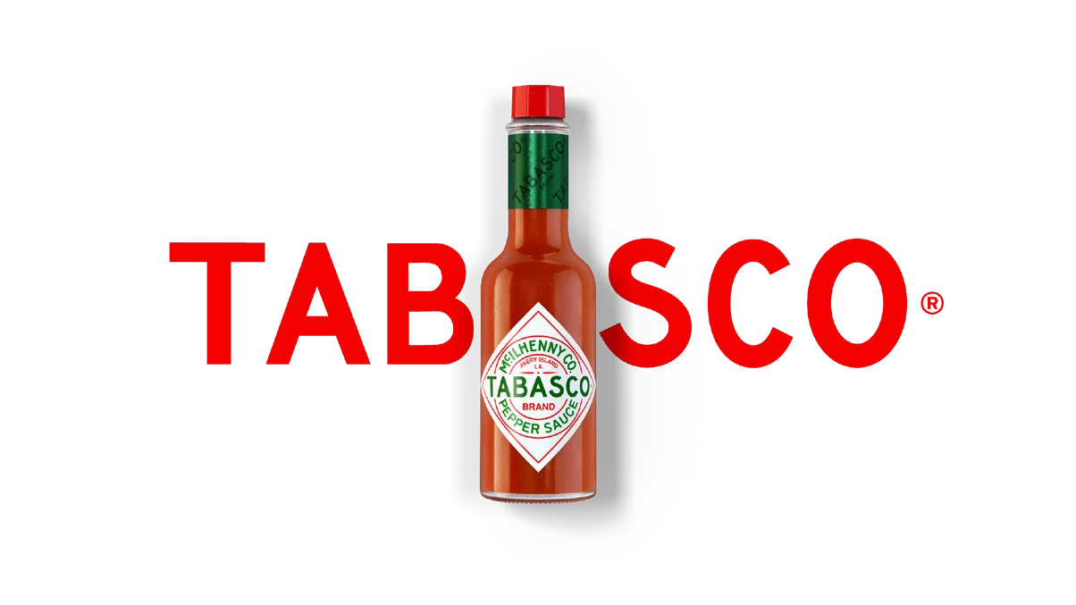
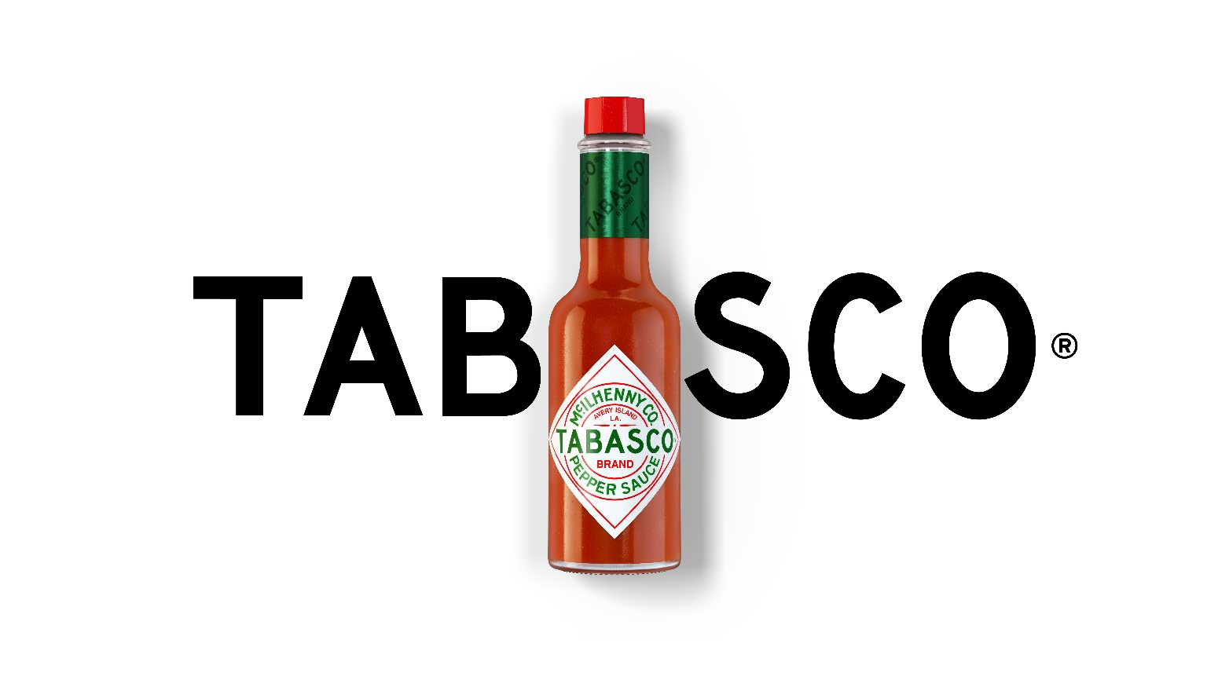
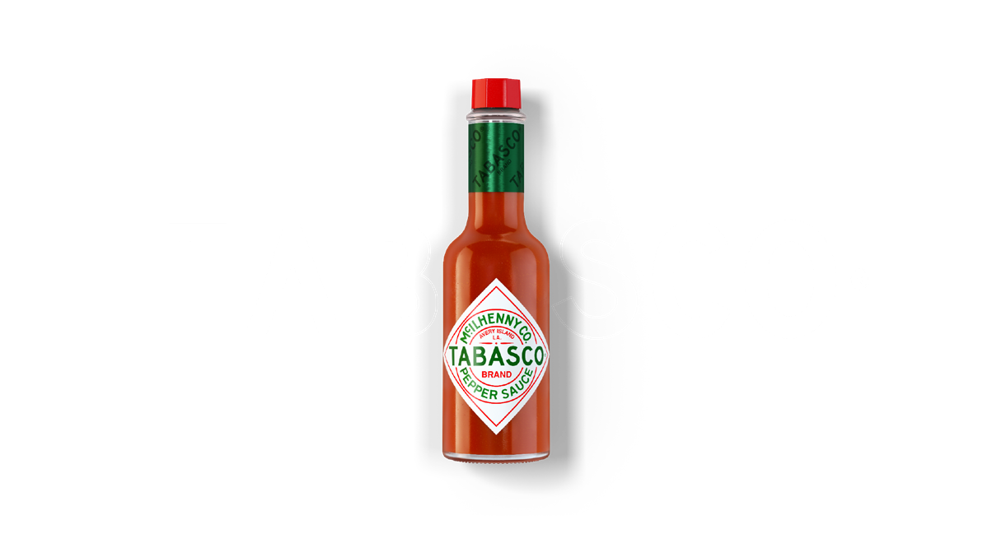
BOTTLE WORDMARKS
Reach out to your TABASCO® Brand Contact to request access to these brand asset files.
HALFTONE BOTTLE LOGO
This version of the bottle logo is ideal when printing capabilities are limited
BOTTLE LOGO
A visual shorthand combining the bottle and wordmark in a bold and visually arresting way

Slide 14
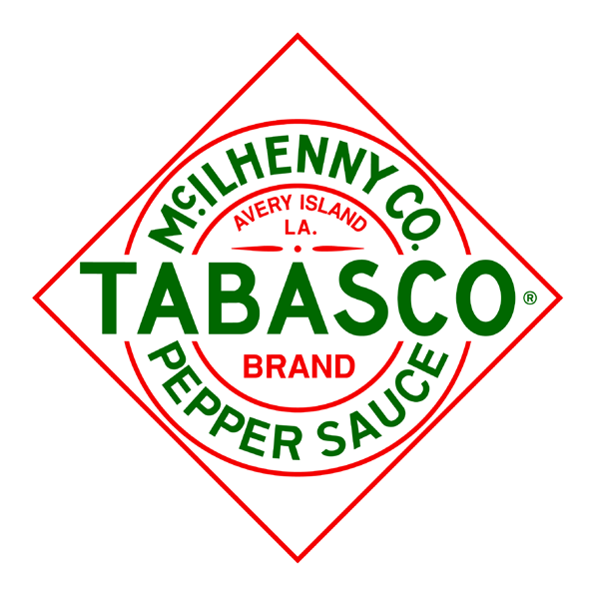
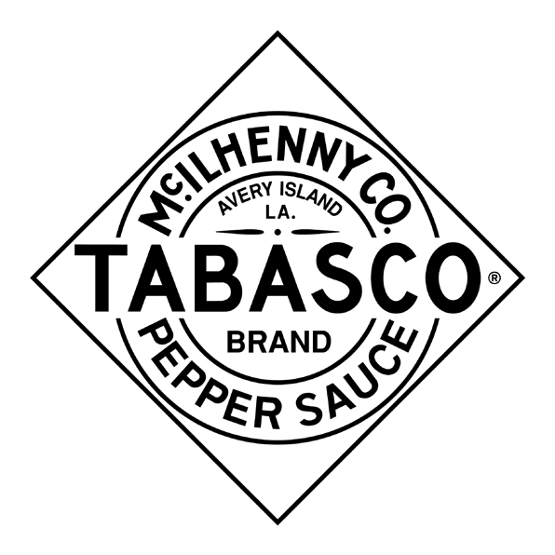
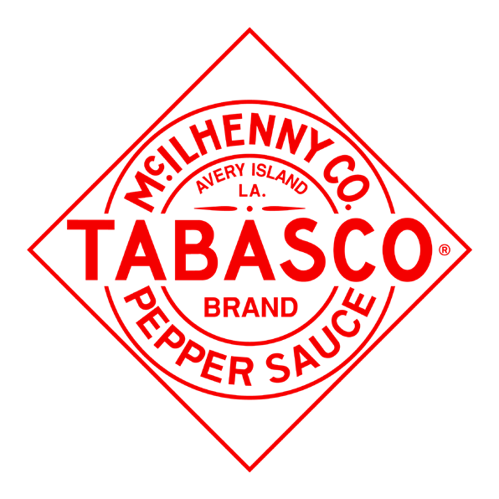
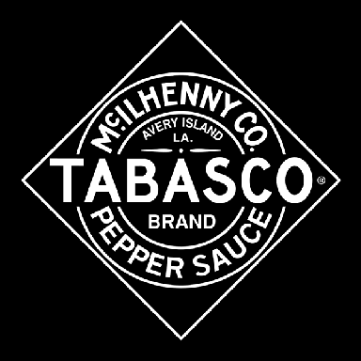


DIAMOND LOGOS
Reach out to your TABASCO® Brand Contact to request access to these brand asset files.
TABASCO® BRAND DIAMOND LOGOS
LIGHT THINGS UP TAGLINE LOGOS

Slide 15
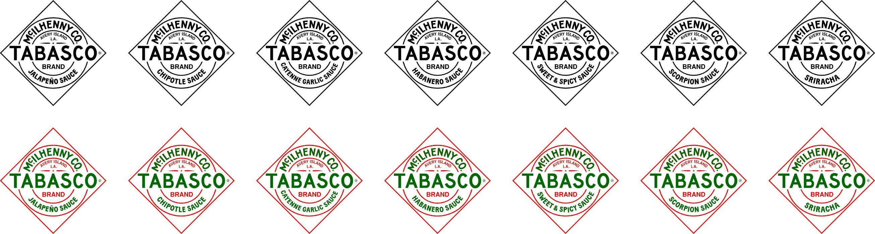
FLAVOR SPECIFIC LOGOS
Reach out to your TABASCO® Brand Contact to request access to these brand asset files.

Slide 16
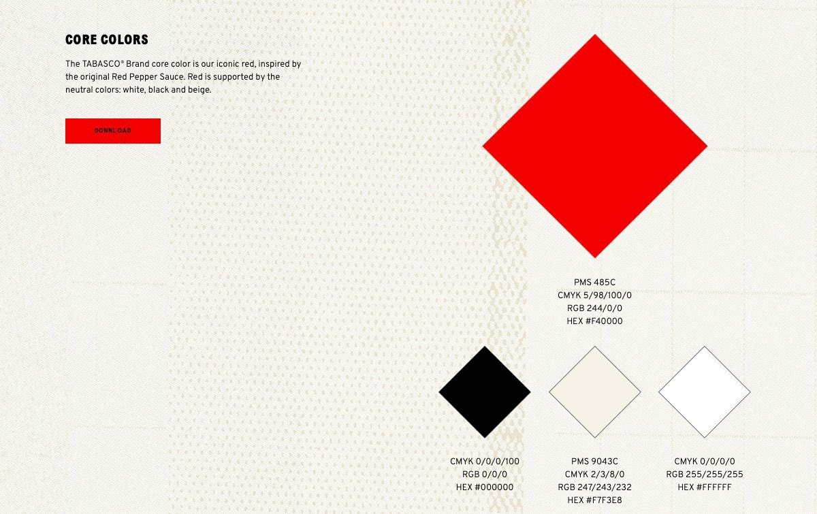
CORE COLORS

Slide 17
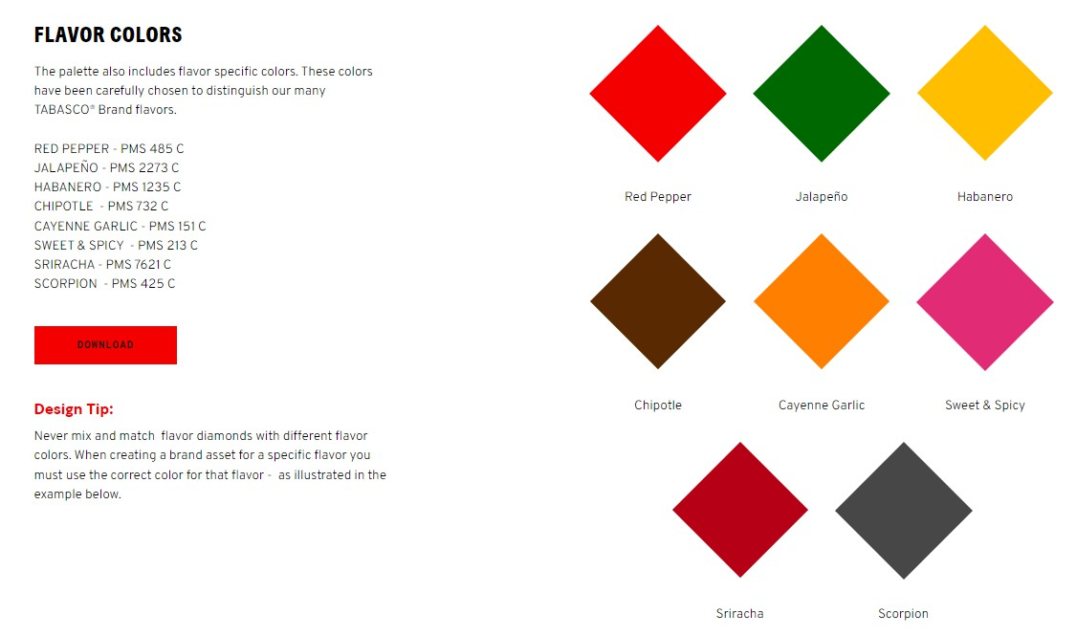
FLAVOR COLORS

Slide 18
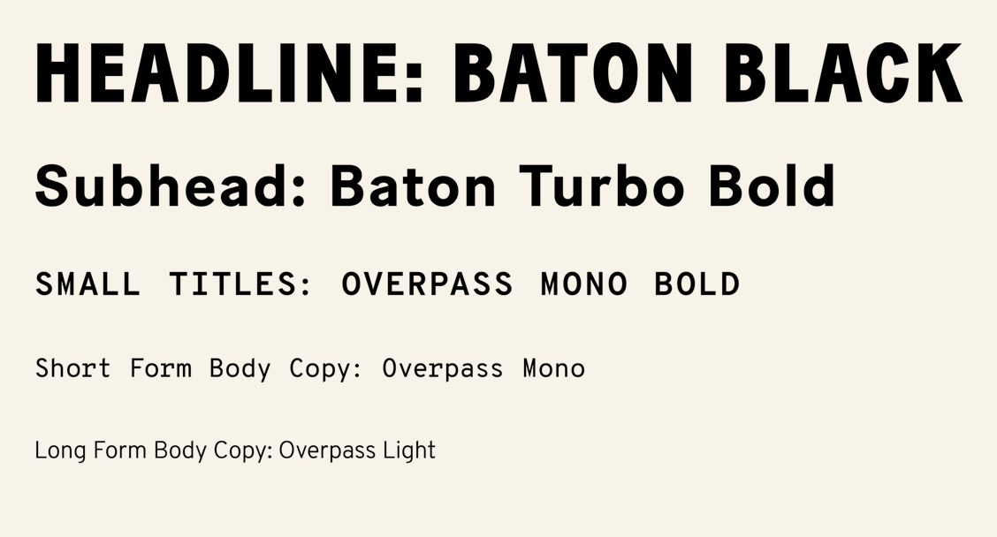
TYPOGRAPHY

Slide 19
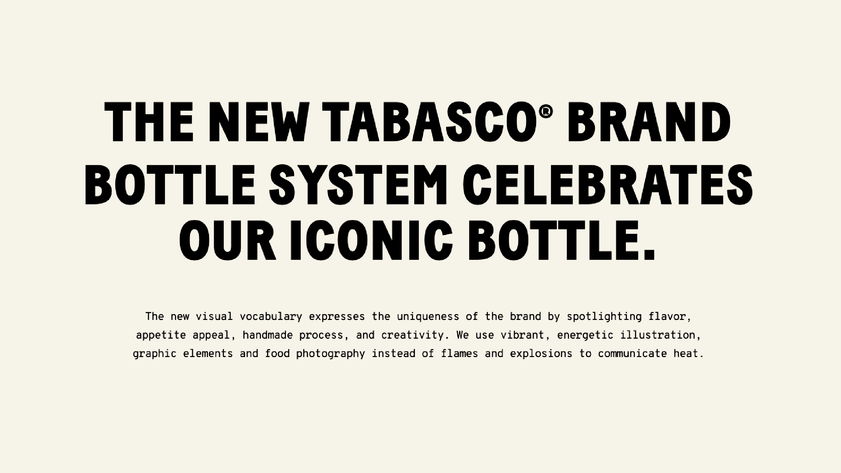

Slide 20
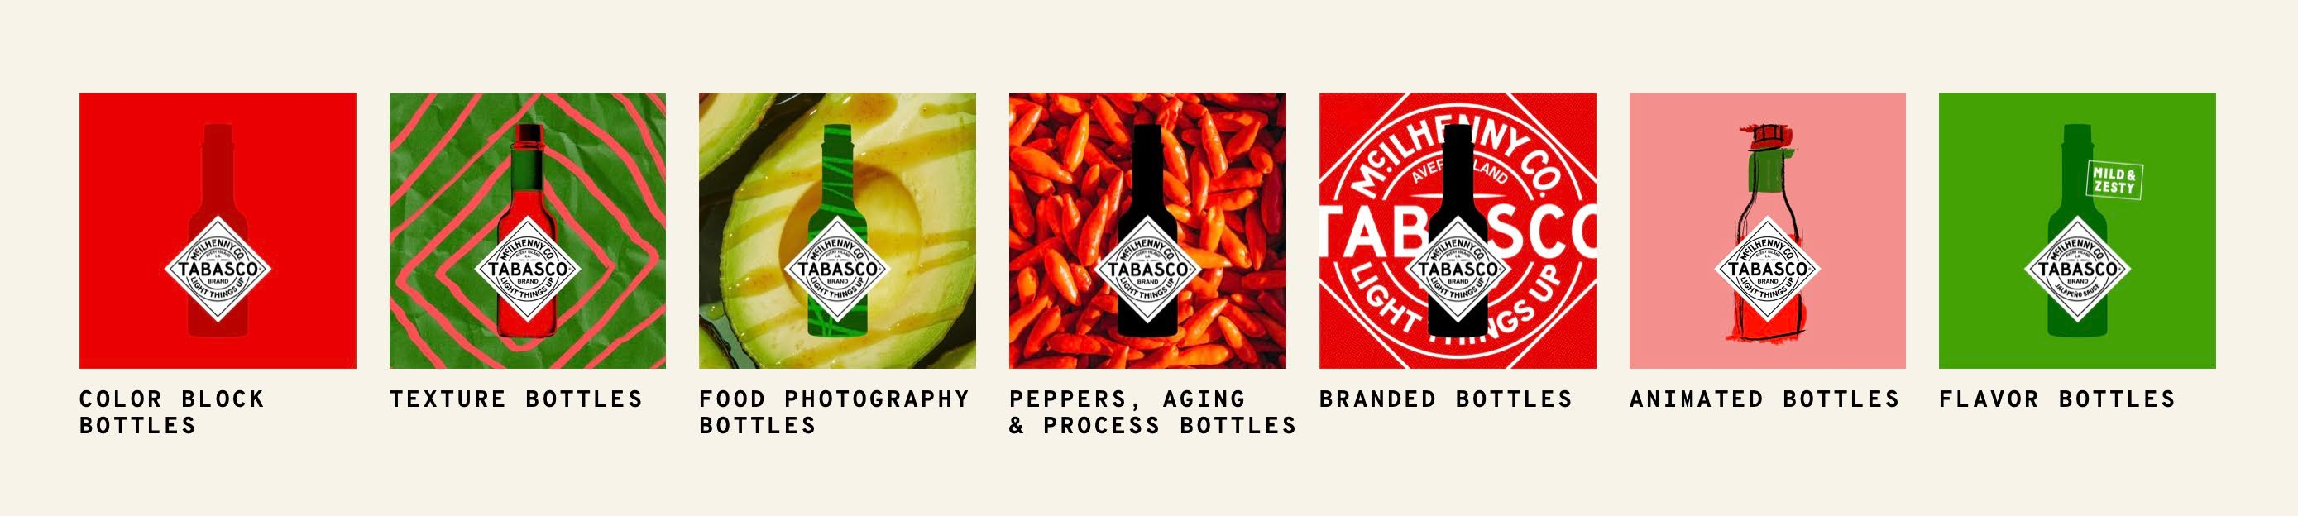
BOTTLE LIBRARY OVERVIEW
The next few slides show how the bottle library comes to life and all of the options available

Slide 21
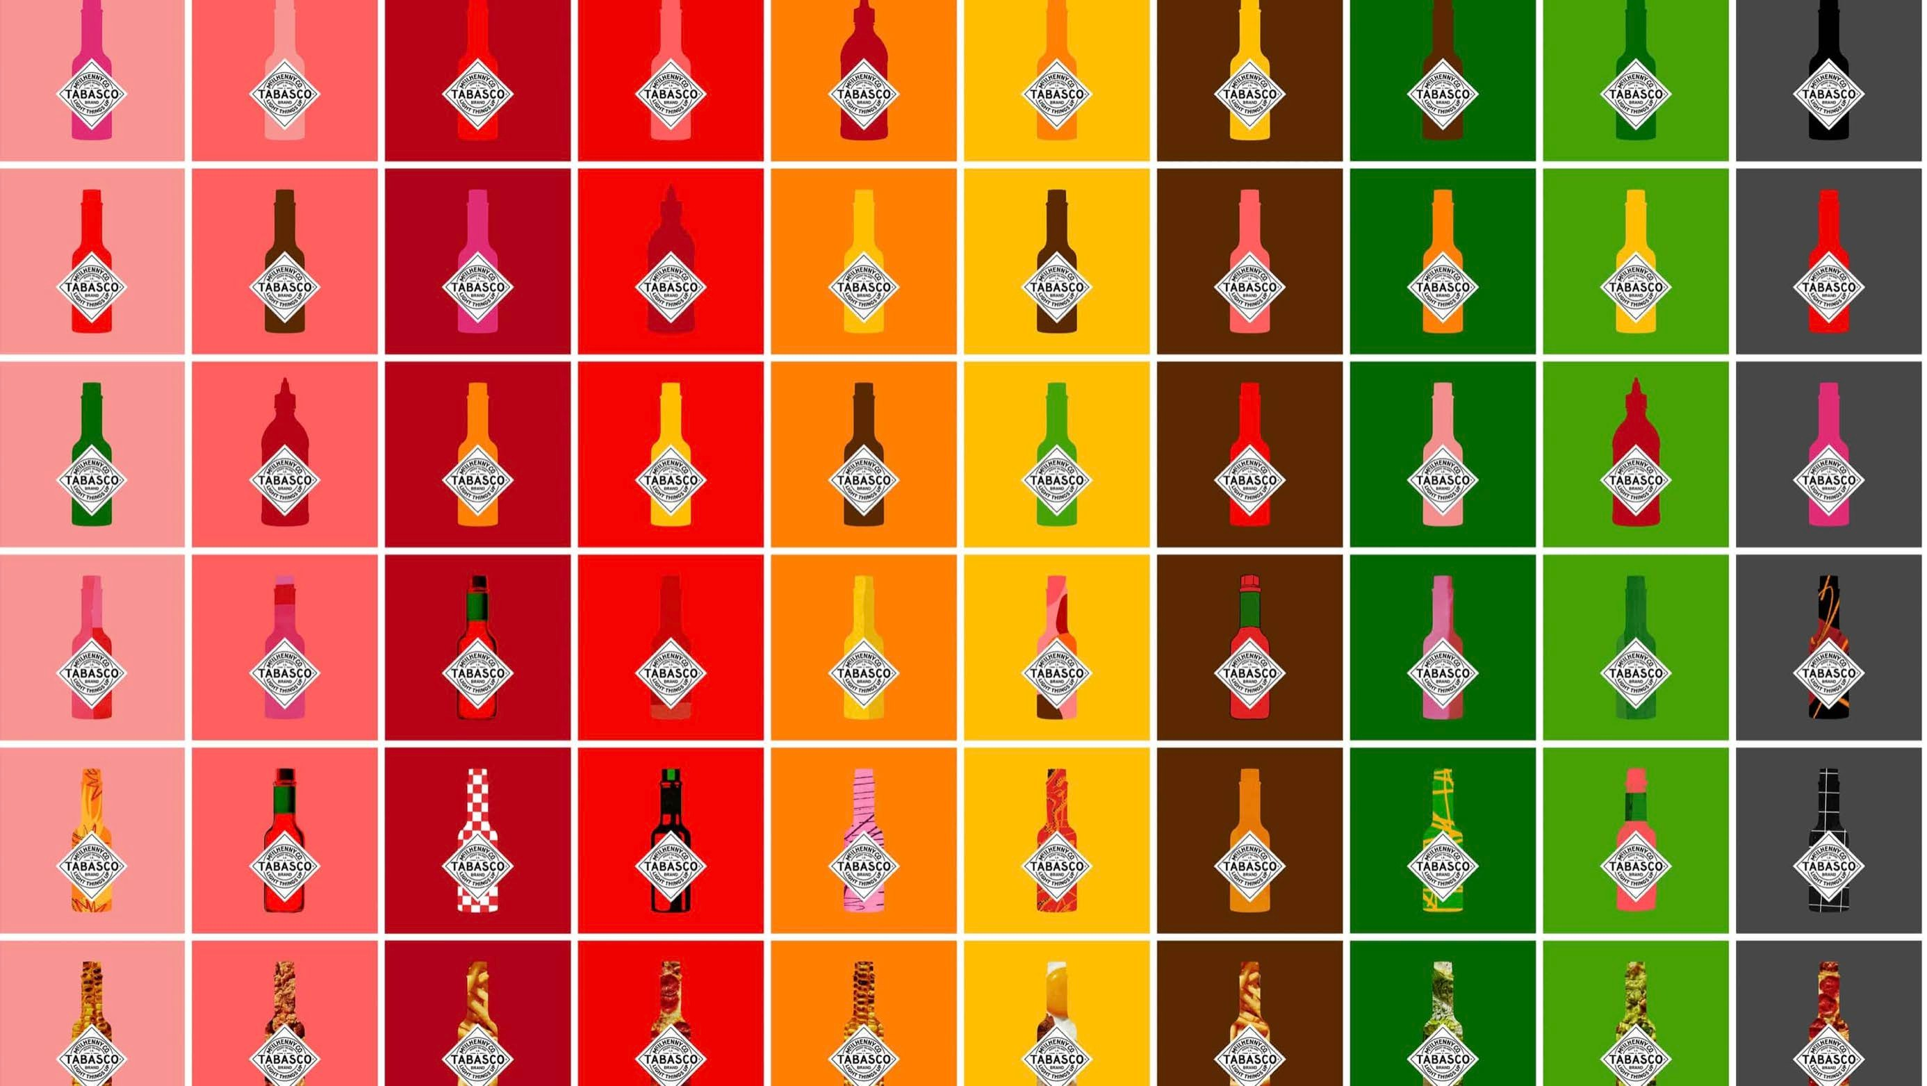

Slide 22
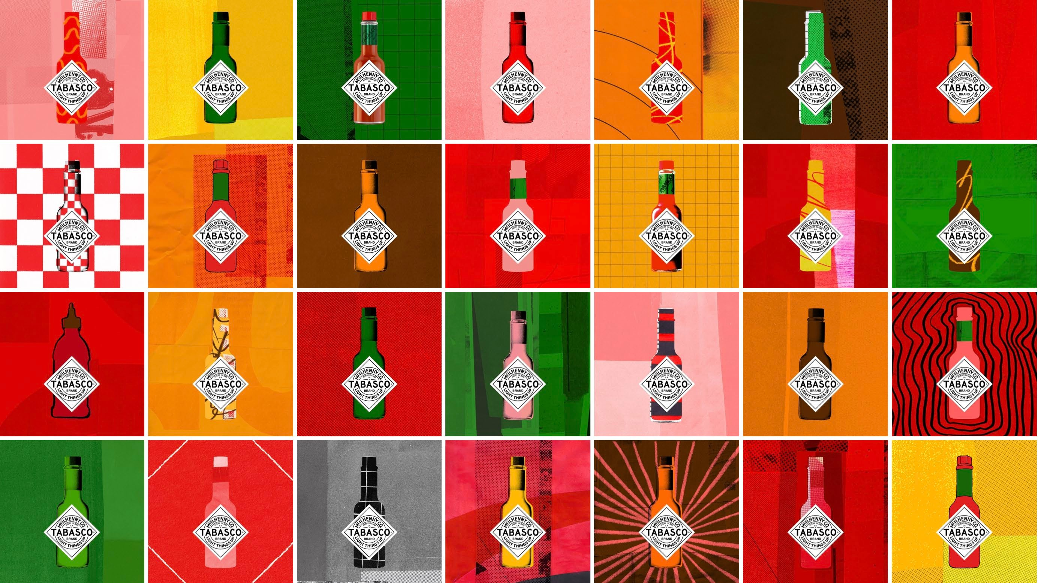

Slide 23
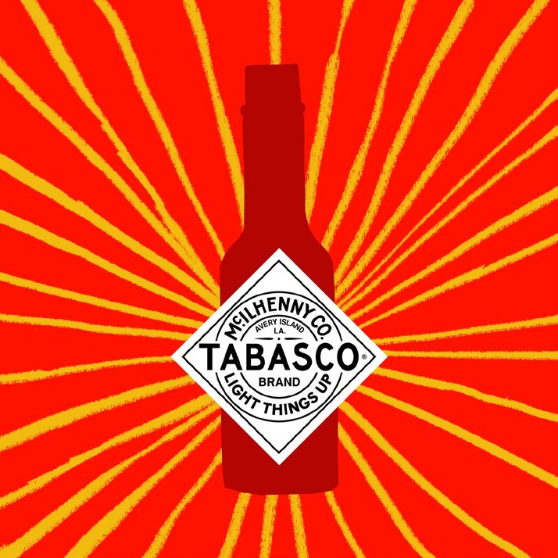
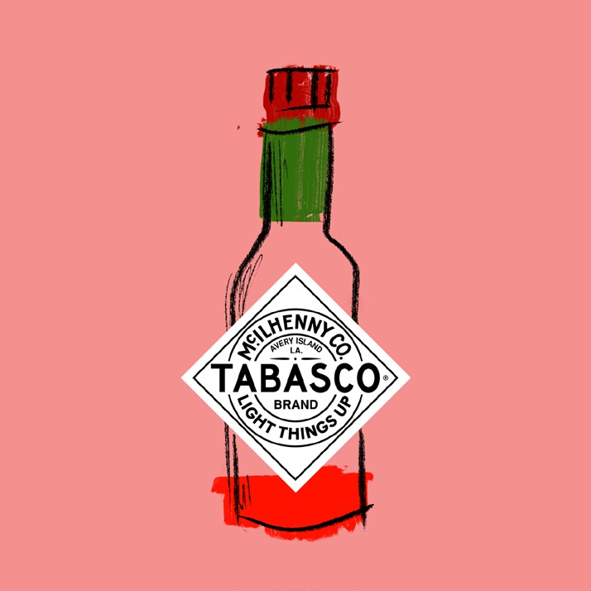
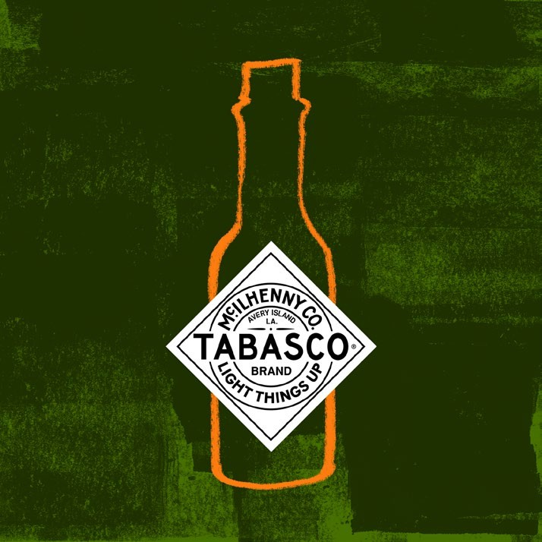
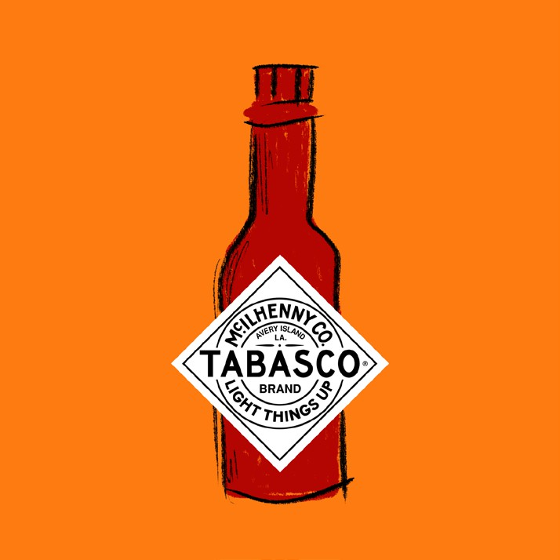
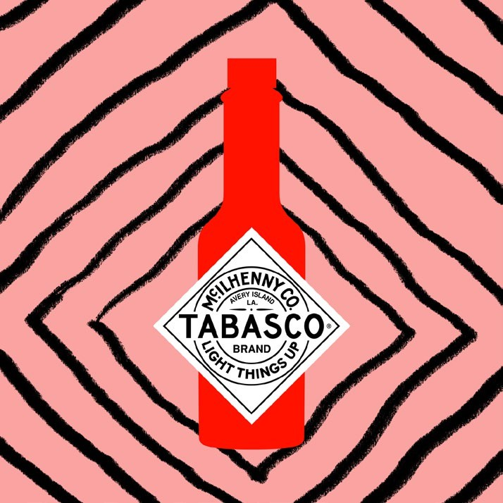
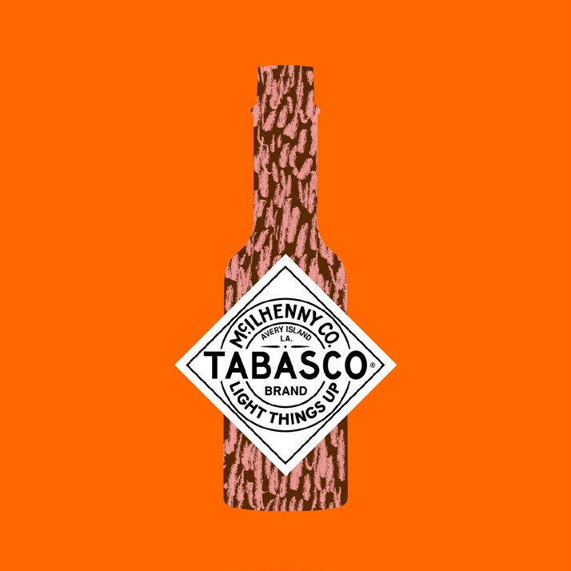
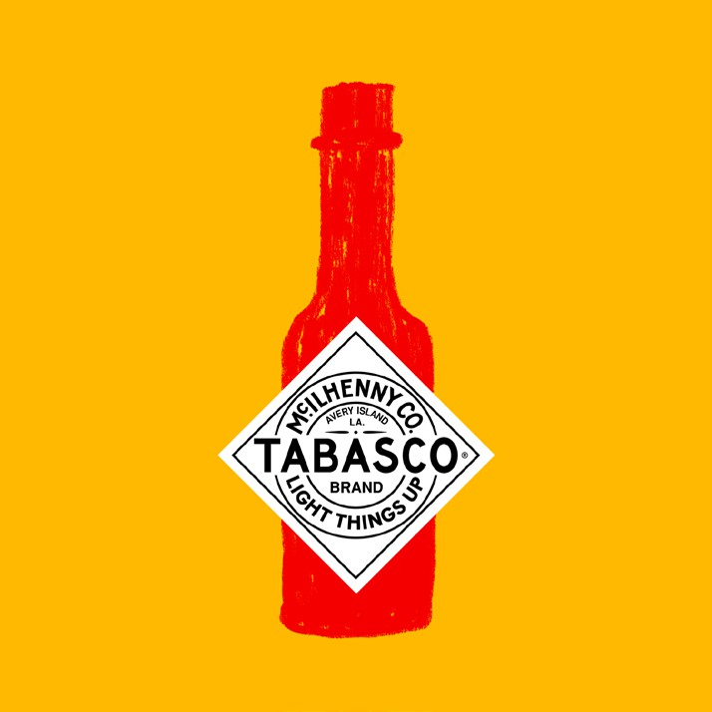
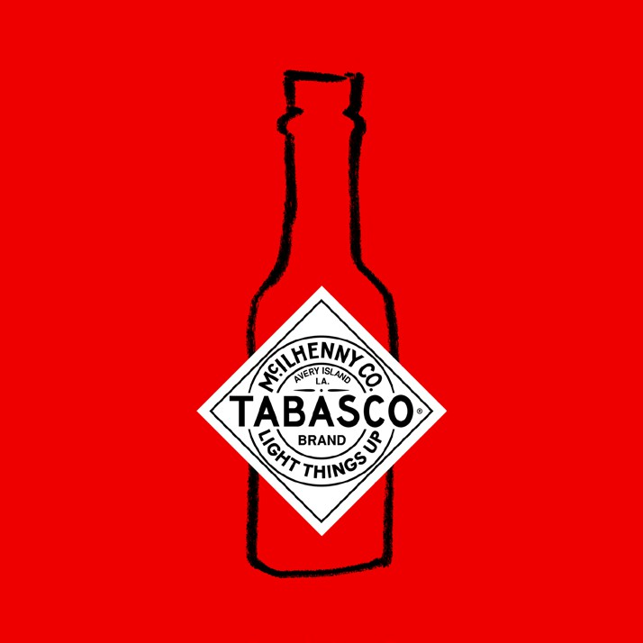
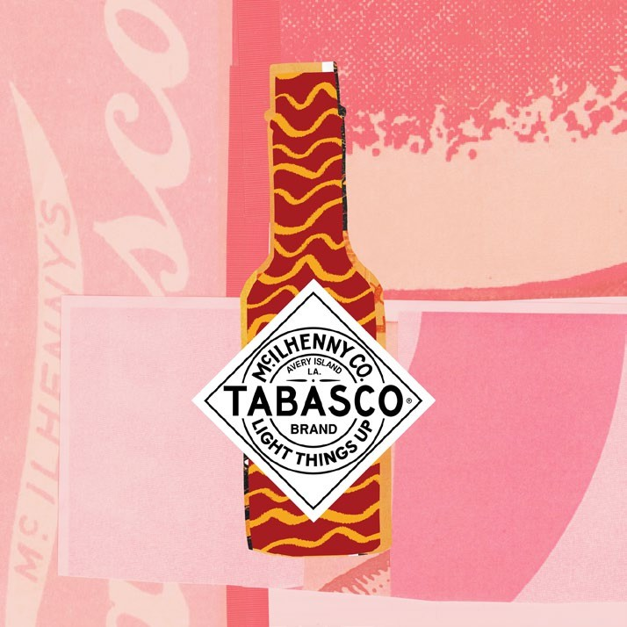
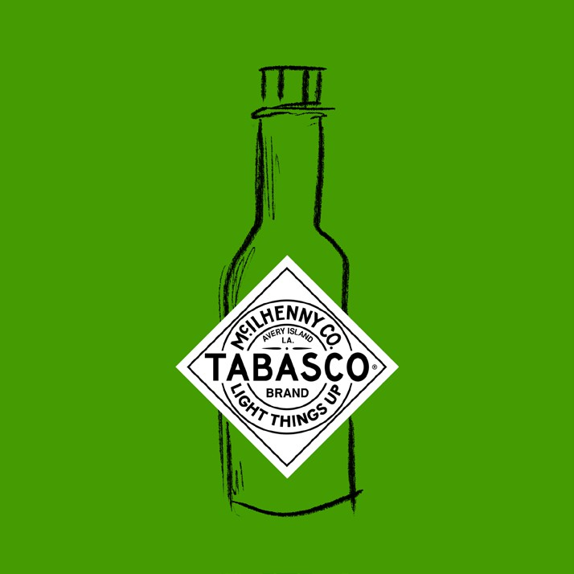
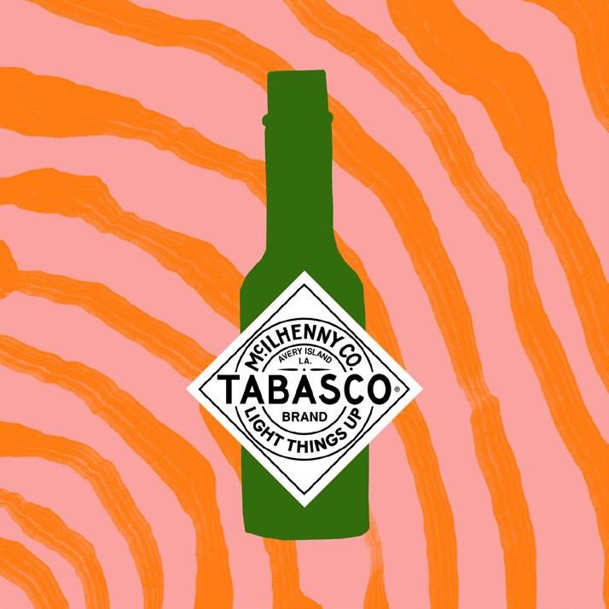

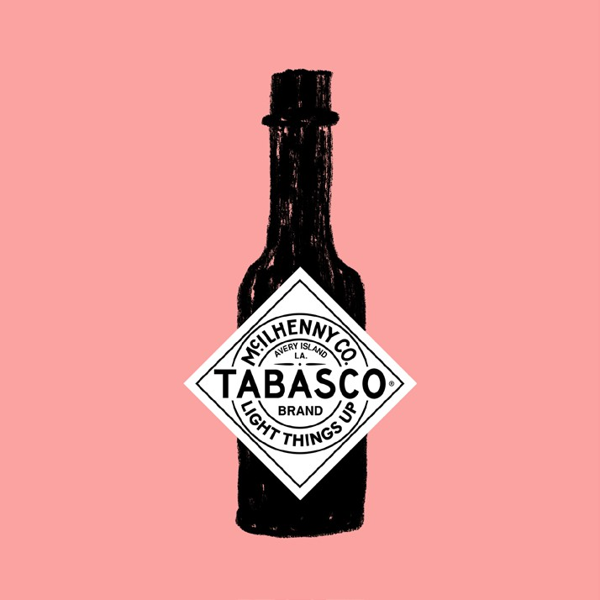
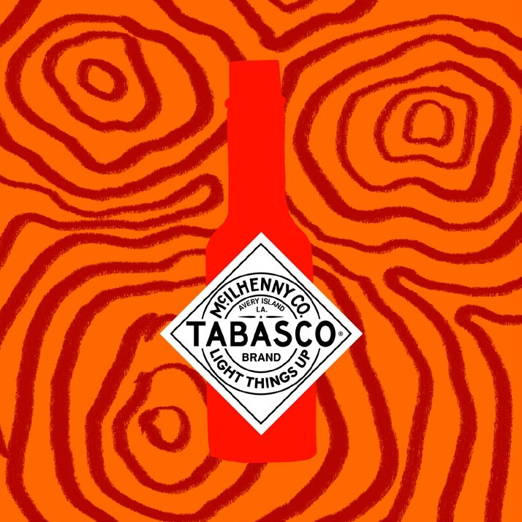

Slide 24
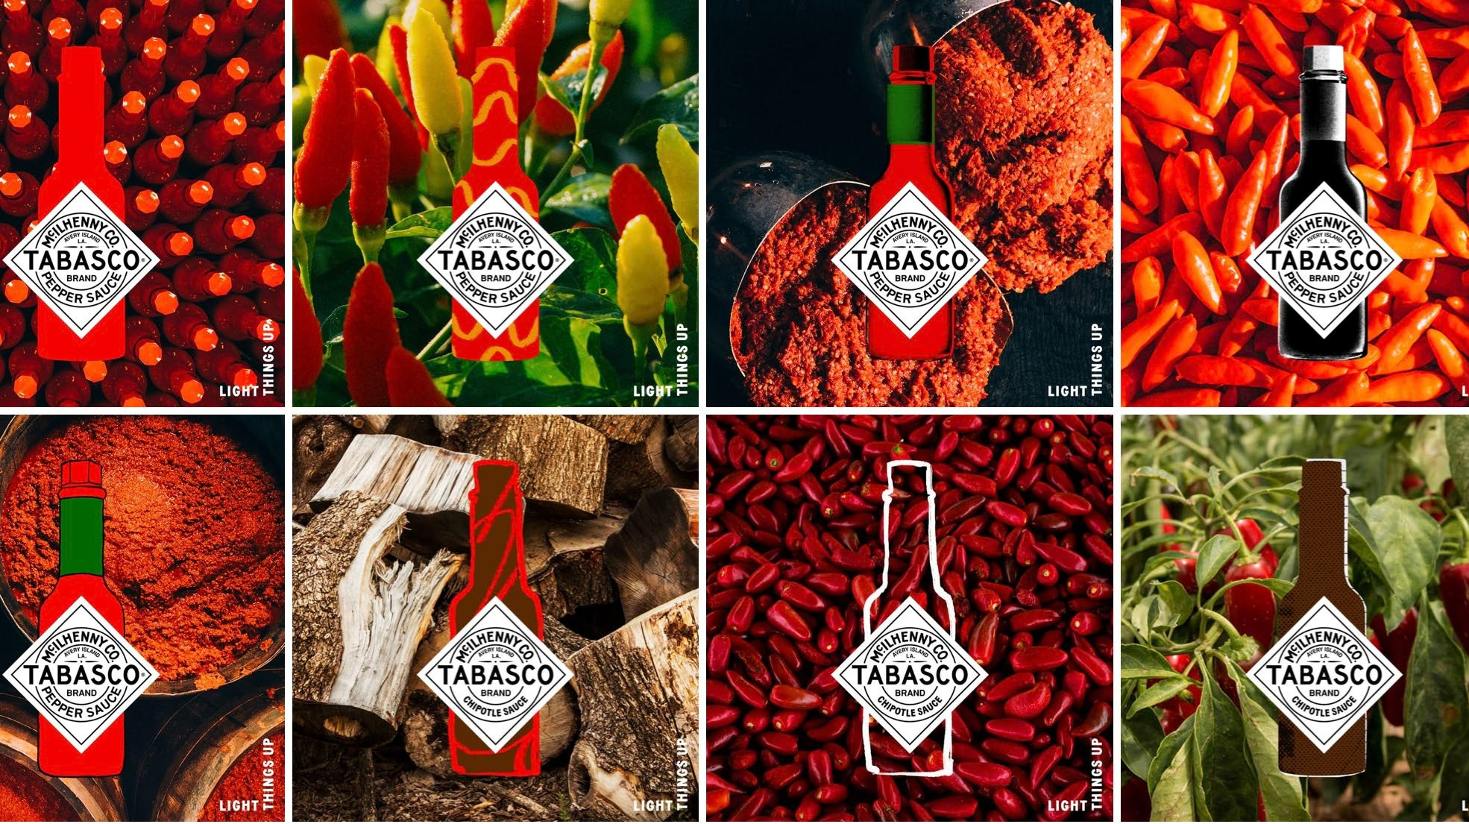

Slide 25
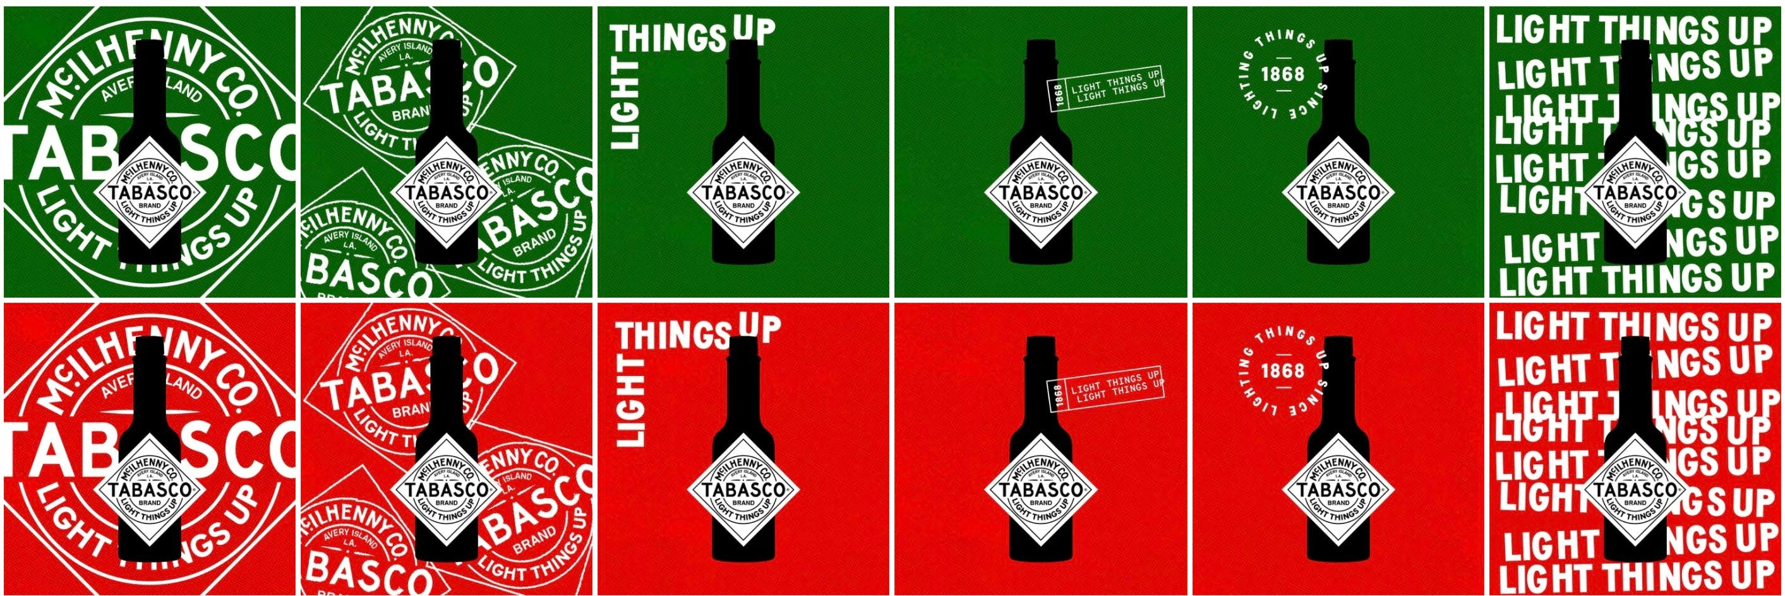

Slide 26
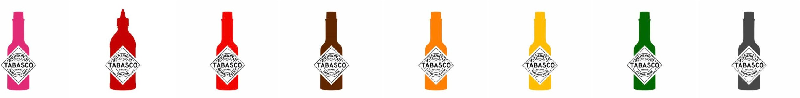
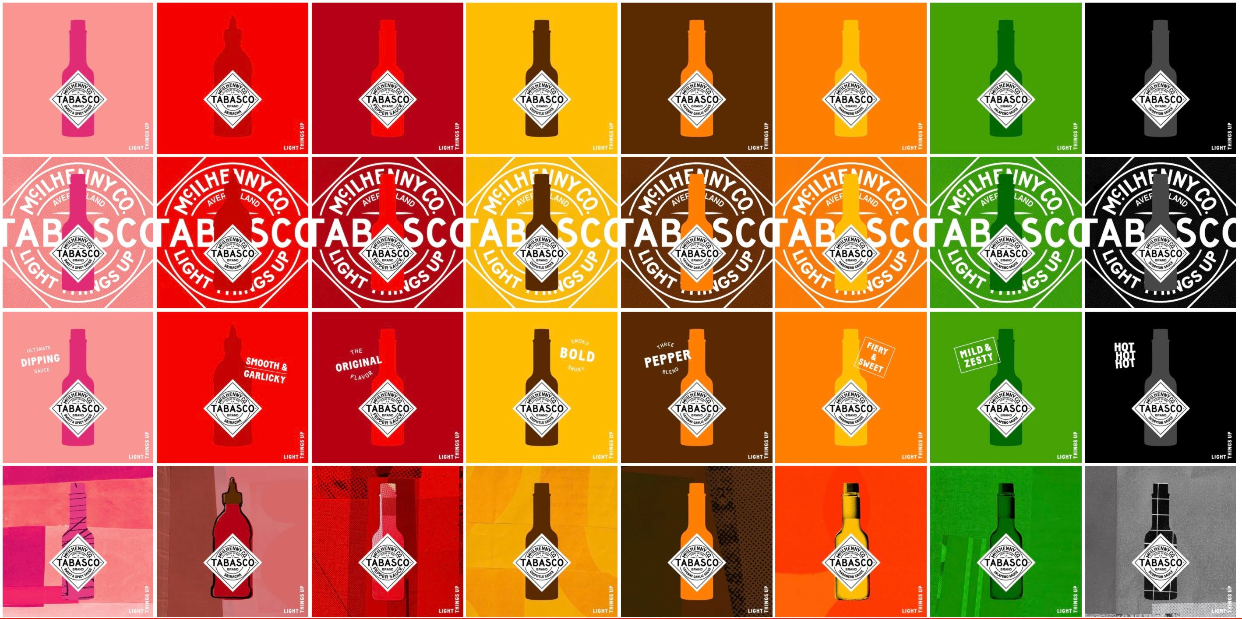

Slide 27


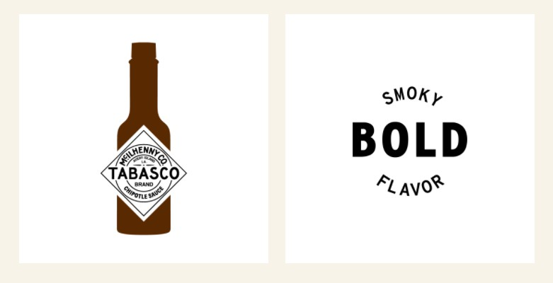

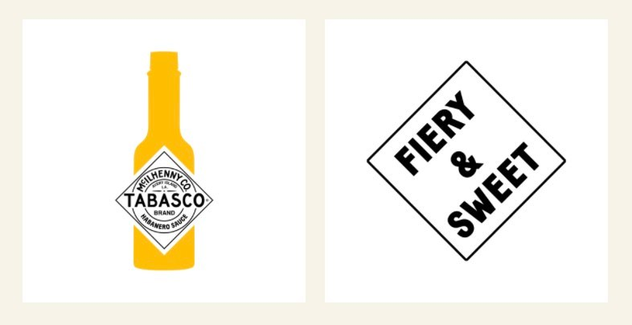
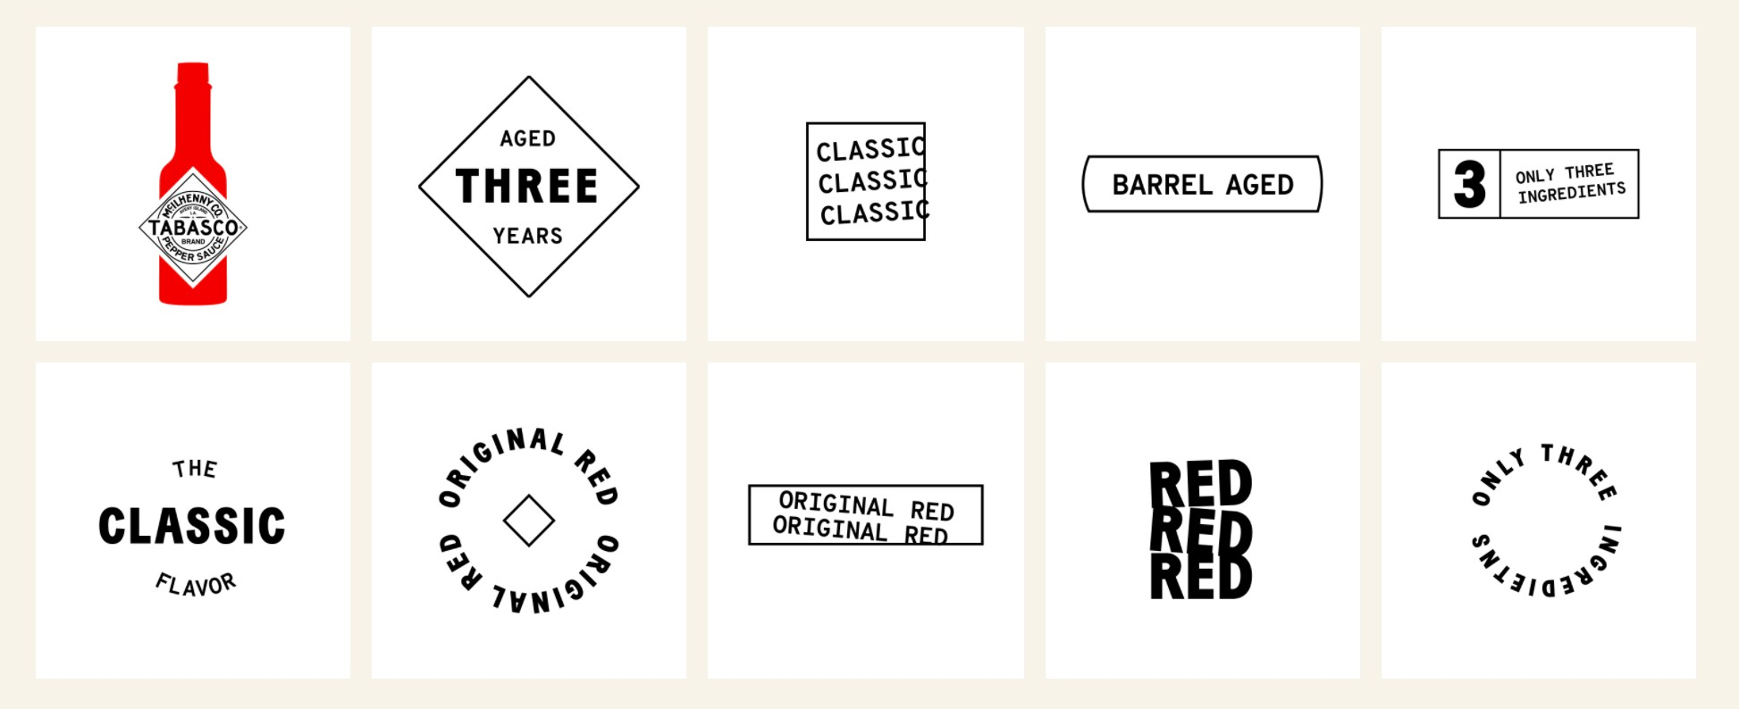

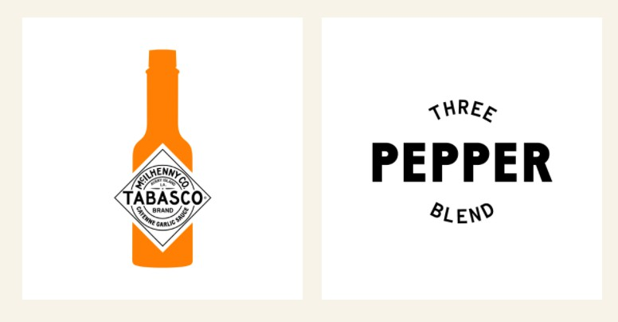
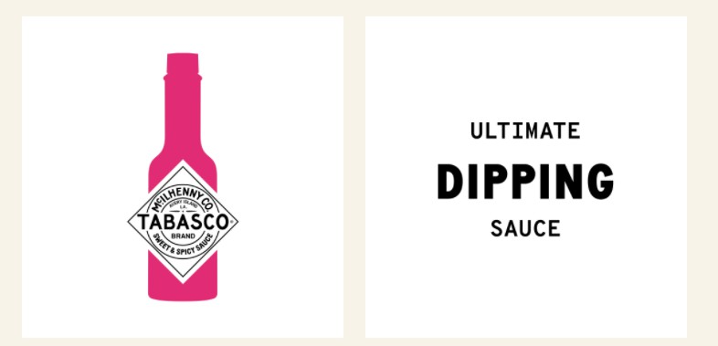
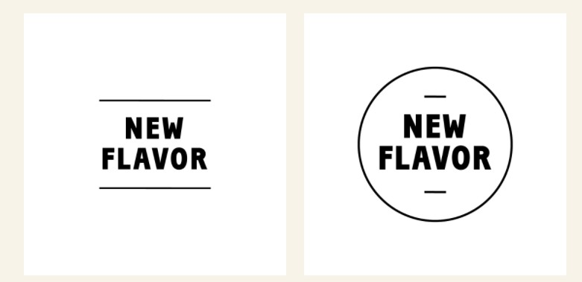
STAMPS
Used to convey messaging about the tagline and the flavor descriptors in an efficient and visually interesting way

Slide 28
TRADEMARK/LEGAL GUIDELINES

Slide 29
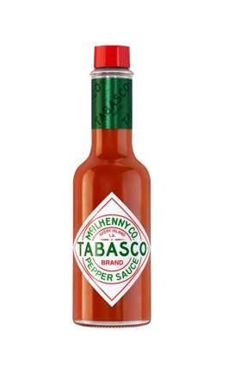
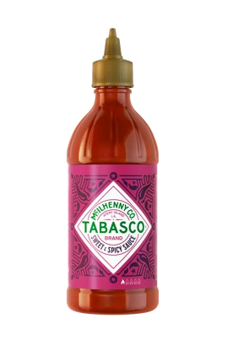
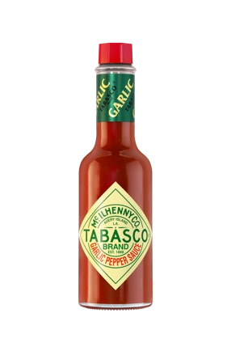
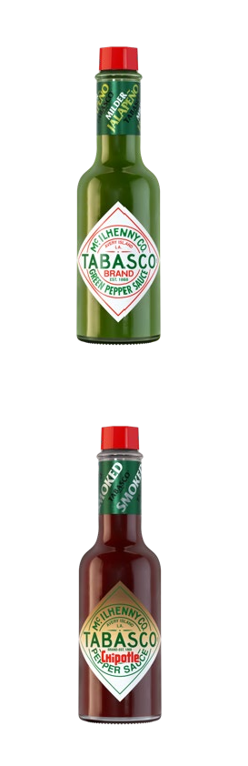




PRODUCT NAMES: AT A GLANCE
Product name options when writing ad copy, company brochures, press releases, etc. The first mention of the sauce
must be the bolded, official name. Subsequent mentions, dependent on space or best context, may use the other options listed.
TABASCO® Brand Pepper Sauce
TABASCO® Brand Sweet & Spicy Pepper Sauce
TABASCO® Brand Garlic Pepper Sauce
TABASCO® Sauce
TABASCO® Original Red Sauce
TABASCO® Sweet & Spicy Sauce TABASCO® Brand Sweet & Spicy Sauce
TABASCO® Brand Garlic Pepper Sauce TABASCO® Garlic Sauce
TABASCO® Garlic Pepper Sauce
INTERNATIONAL:
TABASCO® Brand Jalapeño Sauce
TABASCO® Brand Buffalo Style Hot Sauce
TABASCO® Brand Habanero Pepper Sauce
TABASCO® Jalapeño Sauce
TABASCO® Buffalo Style Sauce TABASCO® Buffalo Style Hot Sauce
TABASCO® Habanero Sauce TABASCO® Habanero Pepper Sauce
US:
TABASCO® Brand Green Pepper Sauce
TABASCO® Green Sauce
TABASCO® Brand Green Jalapeño Pepper Sauce TABASCO® Green Jalapeño Pepper Sauce TABASCO® Green Jalapeño Sauce
TABASCO® Brand Chipotle Pepper Sauce
TABASCO® Brand Sriracha Sauce
TABASCO® Brand Scorpion Sauce
TABASCO® Chipotle Sauce TABASCO® Chipotle Pepper Sauce
TABASCO® Sriracha Sauce
TABASCO® Scorpion Sauce TABASCO® Scorpion Pepper Sauce
TABASCO® Brand Scorpion Pepper Sauce
Bolded wording denotes proper product name for use with ingredient statements.

Slide 30
NAMING GUIDELINES
One
For co-branded products or menu items, TABASCO® Brand should never appear as the dominant brand.
Two
‘TABASCO®’ word mark must always appear in all capital letters with the ® in superscript.
The word may never appear in lower case.
Three
‘TABASCO®’ word mark must always be used as an adjective and never as a noun or a verb.
Acceptable nouns after ‘TABASCO®’ are either ‘Brand’ or naming guidelines listed on slide 30.
Six
Please refrain from using the word “original” in any marketing. The only time ‘original’ can be used is: Original Red Sauce. Additionally, do not use the description ‘heirloom’ to describe the peppers. The proper reference is ‘red pepper’.
Four
Anytime the word ‘Brand’ is used, the “B” should be capitalized in all instances. Example: TABASCO® Brand, TABASCO® Brand Pepper Sauce.
Five
The ‘c’ in McIlhenny should always be lower case.
Example: McIlhenny Company
or McILHENNY COMPANY

Slide 31

NAMING GUIDELINES CONTINUED
Seven
When naming a menu item/product that has a TABASCO® Brand product in it, any reference to the TABASCO® Brand must be as an ingredient only and not as a TABASCO® Branded dish.
Eight
When using an industrial ingredient (slide 31) in the product, the marketing material/naming of the product should always refer to the product as being ‘spiced’ or ‘infused’ or ‘flavored’ with TABASCO® Sauce flavor or TABASCO® Brand seasoning.
Nine
When using one of the other TABASCO® Brand flavors use the appropriate naming structure as mentioned previously.
Ten
When using multiple TABASCO® Brand Ingredients (sauce or industrial), please name the product as ‘spiced with TABASCO® Brand Seasonings’ or you can list out the flavors correctly.
Incorrect: TABASCO® Chicken or TABASCO® Flavored Chicken Correct: Chicken spiced with TABASCO® Sauce
Incorrect: Chicken spiced with TABASCO® Sauce
Correct: Chicken spiced with TABASCO® Sauce Flavor or Chicken spiced with the flavor of TABASCO® Sauce
Incorrect: Chicken spiced with habanero sauce
Correct: Chicken spiced with TABASCO® Habanero Sauce
Incorrect: Chicken spiced with TABASCO® sauce, green sauce and habanero sauce
Correct: Chicken spiced with TABASCO® Brand Seasonings or Chicken spiced with TABASCO® Sauce, TABASCO® Green Sauce and TABASCO® Habanero Sauce

Slide 32








BOTTLE PHOTOGRAPHY & LOGO USAGES
When using a specific bottle photography image or diamond logo, please use the flavor that correlates with the product used in the dish/product
TABASCO® Brand Pepper Sauce
TABASCO® Brand sauces:
*Using the bottle photography is the preferred method on co-branded menu items/products

Slide 33



BOTTLE PHOTOGRAPHY & LOGO USAGES
Please ensure when using the bottle photography or diamond logos that nothing blocks the words listed in the diamond.
Correct: nothing is blocking the diamond logo
Acceptable: an item is placed in front but you can still read ‘Sauce’
Incorrect: The word ‘Pepper’ is not legible

Slide 34
TRADEMARK NOTICE
The following trademark notice must be used on packaging, tags, labels, etc.
For products use the traditional glass bottle range:
For TABASCO® Sriracha or TABASCO® Sweet & Spicy squeeze bottles:
TABASCO and the DIAMOND and BOTTLE LOGOS are trademarks of and licensed by McIlhenny Company, Avery Island, Louisiana 70513 USA. TABASCO.com
TABASCO and the DIAMOND LOGO are trademarks of and licensed by McIlhenny Company, Avery Island, Louisiana 70513 USA. TABASCO.com
OR
OR
TABASCO and the DIAMOND and BOTTLE LOGOS
are trademarks of and licensed by McIlhenny Co
TABASCO and the DIAMOND LOGO are trademarks of and licensed by McIlhenny Co
*If at all possible, please do not separate the words “Avery Island” or “McIlhenny Company” on two separate lines. The trademark symbol ® is not needed in the trademark notice

Slide 35
CREATIVE GUIDELINES
For any creative (TVC, radio advertisements, social media content, POSM, etc.), TABASCO® Brand does not condone the following:
Anything that is obscene, abusive or defamatory
Containing vulgar/inappropriate language
Bullying/making others feel uncomfortable
Fraudulent, deceptive or misleading
Including religious or political topics
Anything that may be in violation of someone else's ownership or intellectual property rights
Anything that may be in violation of any law or regulation
Uses the TABASCO® Brand bottle to cause harm to anyone

Slide 36






GLOBAL SOCIAL MEDIA
If you’re posting about your partnership on social media, please send any creative to your TABASCO® Brand contact for consideration on the global TABASCO® Brand channels
#1 MOST FOLLOWED HOT SAUCE BRAND ACROSS ALL MAJOR SOCIAL MEDIA PLATFORMS GLOBALLY ACROSS TIKTOK, INSTAGRAM, FACEBOOK, TWITTER AND PINTEREST
4.3MM FOLLOWERS ACROSS OUR MAJOR PLATFORMS
X2 DEDICATED GLOBAL PLATFORMS: INSTAGRAM & TIKTOK 46.7% OF OUR FOLLOWERS ON INSTAGRAM ARE BETWEEN
18-34
To learn more about how we #LightThingsUp, follow us on Facebook, Instagram, Twitter, TikTok and LinkedIn.

Slide 37
PLEASE REACH OUT TO YOUR TABASCO® BRAND CONTACT FOR ANY QUESTIONS.
ALL CREATIVE WITH ANY TABASCO® BRAND TRADEMARKS MUST BE APPROVED.

